Slide 1
Chwarae Teg
Building a Fairer Wales where Women can achieve & prosper
Stephanie Griffiths
Senior Participation Partner – Chwarae Teg
07495 562974

Slide 2
Chwarae Teg
Vision
“A Fairer Wales where women achieve and prosper.”
Mission
“To expand the role of women in the Welsh economy.”

Slide 3
Chwarae Teg’s Vision
“Building a Fairer Wales where women achieve and prosper.”
Policy & Research
Women in Public Life
Sky’s Her Limit
Womenspire Awards
HIVE & Industry Networks
Agile Nation 2
Supporters & Networks
Agile Nation 2
Wonderful Welsh Women
Incubator space – co-working environment for female entrepreneurs
Marketplace – online directory of female led businesses
Currently working on publishing case studies featuring women in business for Business Wales

Slide 4
Agile Nation 2
The aim of Agile Nation 2 is to promote gender equality, career advancement and improve the position of women in the workforce across all nine priority sectors in Wales.
This is an important undertaking as women continue to be underrepresented in these sectors.
The aim of Agile Nation 2 is to promote gender equality, career advancement and improve the position of women in the workforce across eleven priority sectors in Wales. This is an important undertaking as women continue to be underrepresented in these sectors.
“Our work over coming years will focus on the companies and sectors that have been identified as important to the growth of the Welsh economy. Many of these sectors experience both significant skills gaps and the under-representation of women”
Joy Kent, Former Chief Executive, Chwarae Teg
In Blaenau Gwent women are paid on average £4.53 an hour less than men. Women are working unpaid from the 4th September. (BBC Wales, November 2017)
The gender pay gap in Wales is currently wider than any where else in the UK.
(BBC Wales, November 2017)
The Gender pat gap in Wales has decreased in recent years from 27.8% in 1997 to 15.5% in 2016.
(ONS 2016)
Notes:
12.3 % difference in 19 years.

Slide 5
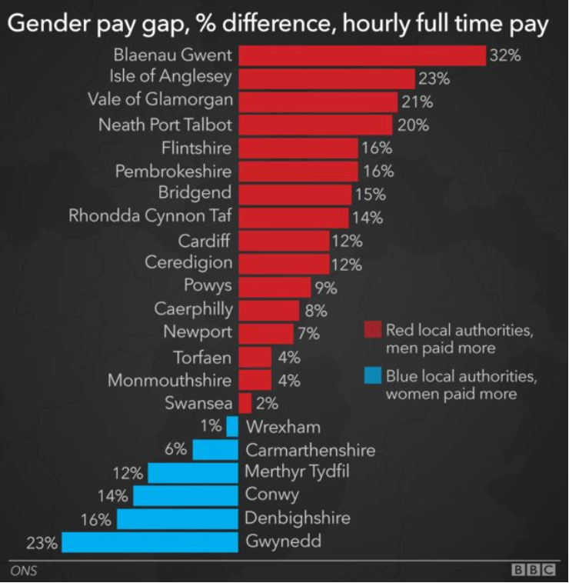
Gender Pay Gap Wales
Key Difference’s
One of the main factors in areas like Gwynedd is higher levels of public sector jobs.
Gwynedd – 16,000
Blaenau Gwent – 7,000
Merthyr is only 3 miles from Blaenau Gwent but has Hospitals, Welsh Government Office’s and a large retail sector who all employ majority female.
World Economic Forum 2017 report states it will take 207 years to achieve gender parity.

Slide 6
#MAKEYOURSELF
Career Development Programme

Slide 7
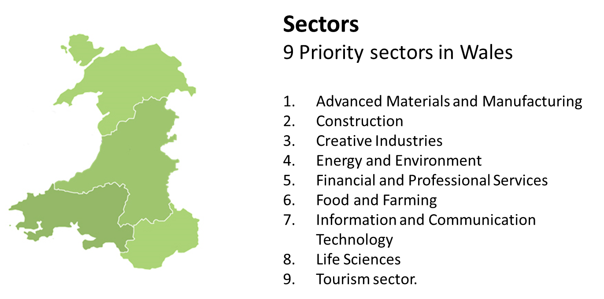
Who is it for?
Sectors
11 Priority sectors in Wales
Advanced Materials and Manufacturing
Construction
Creative Industries
Energy & Environment
Financial and Professional Services
Food and Farming
Information and Communication Technology
Life Sciences
Tourism sector.
Wholesale & Retail Trade
Administrative and Support Services Activities
#MAKEYOURSELF

Slide 8
How does it work?
#MAKEYOURSELF
Career Planning
ILM Qualification
Support
Pick ‘N` Mix
Mentoring
Career Development Programme

Slide 9
#MAKEYOURTEAM
Business Consultancy

Slide 10
How Does it Work?
‘A unique opportunity to review & improve working practice which will be tailored to your business’
1:1 Consultancy from our expert Employer Partners
Business culture survey & full results analysis
Recommended actions and implementation support
An Equality & Diversity Strategy and action plan tailored to your business
Workshops on specific topic to improve understanding
Up to 35 hours fully funded consultancy and support
Eligibility to attain Exemplar Employer Award

Slide 11
Business Culture Survey
12 Month Comparison

Slide 12
Success Stories
Improvements in staff absence levels
Better Recruitment, Selection and induction processes – supports widening the recruitment pool
Increase in staff retention
Flexible working/modern working practices – understanding and implementation
Introducing a flexi start and finish time process and policy
Managing the expectation of your workers – through trained and competent managers – e.g. how to have a conversation
through the medium of appraisal.

Slide 13
Eligibility Criteria
#MAKEYOURSELF
#MAKEYOURTEAM
Priority Sector
Live or Work in Wales
Employed or Self Employed
Role not funded by other European Programmes
Priority Sector
SME
>250 Employees
>£35 Million turnover
Not in receipt of additional European Funding
>£150,000 De Minimis received in last 3 fiscal years
More than 10 Employees

Slide 14
Stephanie Griffiths
Senior Participation Partner
07495 562974
stephanie.griffiths@chwaraeteg.com

