Slide 1


Race Inequality Seminar

Slide 2
Tom Murtha
North Wales Housing
"Race and Housing 40 Years on; What Have We Learned?"

Slide 3
Rocio Cifuentes
EYST Wales
"Class, Race & Refuge – What’s Housing Got To Do With It?"

Slide 4



Class, Race & Refuge: what’s housing got to do with it?
Rocio Cifuentes, EYST Wales Director

Slide 5

A case study...

Slide 6

Housing Inequalities ….then
Rex & Moore’s seminal study from 50 years ago identified:
Racism in private rented sector
Disadvantage in social housing (due to recent migrants’ lack of existing local connections)
Racial stereotyping & assumptions
Poorer housing (damp, less safe)
Overcrowded
Less desirable areas

Slide 7
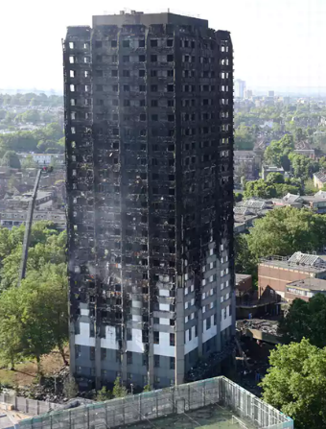
.. And now
White Gypsy and Irish Traveller households are seven and a half times more likely to experience housing deprivation than White British households
Black African households are 75 per cent more likely to experience housing deprivation than White British households.
Bangladeshi households are 63 per cent more likely to experience housing deprivation than White British households.
Households with children are more likely to experience housing deprivation. Bangladeshi and Pakistani households with children are most vulnerable.
Recent migrants to the UK are more likely to experience housing deprivation than those born here.
(Census, 2011)

Slide 8
Runnymede Report:
Local Ethnic Inequalities (2011)
Ethnic inequalities in education, employment, health and housing are widespread in England and Wales and persistent since 2000.
There has been an increase in ethnic inequalities in employment and housing.
Inequality is greatest in employment and housing for all ethnic groups
Ethnic inequalities are found in districts across England and Wales, where there are small and large minority populations with high and low deprivation levels.
Many of the districts that have become more unequal between 2001 and 2011 are less deprived, semi-rural and rural districts with relatively small ethnic minority populations.
Addressing inequality is not purely an issue for authorities with diverse and poor populations

Slide 9
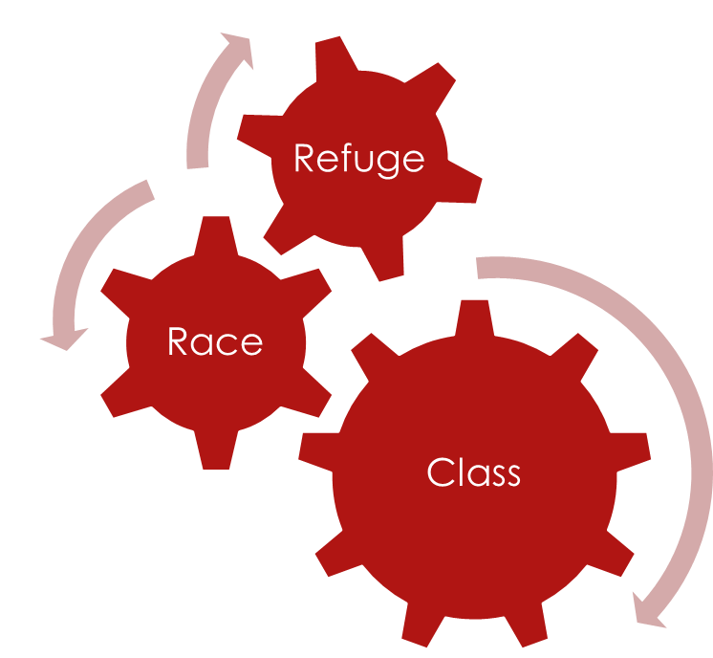
Class, Race & Migration
“Discrimination on the basis of social class features heavily in immigration policy; wealthy migrants can buy their way into the UK whilst poorer overseas migrants are condemned to trafficking, exploitation and legal insecurity and those from within the EU face increasing restrictions on their access to goods and services.”
Robert Moore, 2014 (discoversociety.org)

Slide 10
Forms of Spatial Exclusion
Poorer housing
Worse schools
Poorer health services
Less Green Space
Fewer employment opportunities
Exclusions at the Nation’s Borders and within the Nation’s Borders
‘Racial Steering’ – role of housing market institutions (UK)
  Limit Housing Choice
  Steer towards areas of higher minority concentration
  Discrimination in loan finance
State-sponsored dispersal strategies – Home Office Asylum Dispersal Scheme
Housing & Spatial Patterns matter
  Poor housing quality, overcrowding ,etc
  Poorer health, education, parks etc in areas of poorer housing

Slide 11
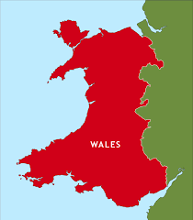
Wales as Refuge
1999 Immigration and Asylum Act → 2000 Home Office Dispersal Scheme disperses Asylum Seekers to Wales
Reaction to perceived unfair share by some Local Authorities + growing numbers of Asylum Seekers
Establishment of NASS (National Asylum Support Service)
Provision of ‘Move On’ support / longer term integration
Syrian Resettlement Programme; Wales: A ‘Nation of Sanctuary’?

Slide 12






Not such a friendly welcome?
Evidence of discrimination and inequality
Welsh Refugee Council Report 2006
Welsh Strategic Migration Partnership
Shelter & Tai Pawb report 2013
Increasing homelessness amongst BME People (Guardian, 2017)
Home office 2017 proposal to deport rough sleeping European Migrants ruled ‘Unlawful’
UKIP, National Action, etc.. All feeding off legitimate grievances around housing crisis

Slide 13
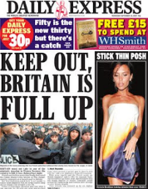

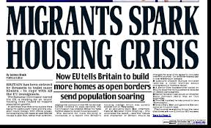
Far Right & the Housing Crisis
Welsh established– National Action
Exploiting grievances of impoverished communities
Fueled by right wing tabloid media
Anti-Muslim, anti-immigrant, anti-asylum-seeker, anti-refugee
Narrative of ‘We need to look after our own’ ‘Britain is full up’
Lack of effective public education and counter-narrative
Post Brexit-Britain – is this a taste of things to come?

Slide 14
Conclusions
Housing is fundamental to a person’s life chances and social mobility
The right to a safe and secure home is enshrined in international law but not directly enforceable
Housing Crisis in context of growing social and economic polarisation and racialisation of competition for resources in Brexit Britain
Housing is key part of state-sponsored policy – where people – especially ‘BME’ and ‘migrants’ are forced to live – we need to be clear about the impact of these policies

Slide 15
Thank you
Rocio Cifuentes
Director
EYST Wales
director@eyst.org.uk @eystwales

Slide 16
Tai Pawb AGM

Slide 17
Alicja Zalesinska
Tai Pawb
"Solutions to Key Issues on Race and Housing in Wales"

Slide 18
Diversity In Housing Governance
Sanjiv Vedi, Hendre Housing Board Member, Chair of Governance.

Slide 19
Welsh Housing Associations'
Board Membership
Gender
Group | Percentage of board members in 2016 | Percentage of population | Percentage of social housing tenants | Chairs
Gender | 42% Female 58% Male Hendre Female 34% Male 66% | 51% | 54% | Female 37% Male 63% Hendre Male Chair

Slide 20
Welsh Housing Association’s Board membership – Young People
Young people | 16% under 45 Hendre 11% 30-44 | 15% under 30 | 20% under 34 | 8% aged 30 to 44,
 | 55% over 45 - 64 Hendre 44% | 45% over 45 | 51% over 50 | 58% aged 45 to 64
 | 29% over 65 Hendre 44% | 18% over 65 | 22% over 60 | 34% over 65

Slide 21
Welsh Housing Association’s Board membership – Ethnic origin
Race | 17 Board members identified themselves as non- white Hendre White 8 Non White 1 | 7% Non white 93% White British | 4% BME 1.21% Black | All white.

Slide 22
Welsh Housing Association’s Board Membership - Disability
Disability | 18% described as having a disability Hendre 60% disability | 20% | 39% | 12%

Slide 23
Welsh Housing Associations Board membership - faith
Faith | 46% Christian 0.27% Islamic | 58% Christian 1.5% Islam | ? | Nil

Slide 24
Hendre’s Tenants data
Total number of tenants 3564
Gender
Male 34.46%
Female 65.29%
Age
16-24 3.51%
25-34 16.13%
35-44 19.22%
45-54 24.41%
55-64 16.53%
65-74 11.22%
75+ 7.21%
Unknown 1.77%

Slide 25
Hendre’s Tenants data
Ethnic Origin
BAME 94
British 414
English 207
European 57
Irish 14
Mixed 22
No answer 23
White 854
Scottish 14
Unknown 386
Welsh 1483

Slide 26
Hendre Tenants Data
Deaf | 0.48%
Hard of Hearing | 0.36%
Health Condition | 4.74%
Learning Difficulties | 0.87%
Mental/Emotional Distress | 4.63%
Multiple | 3.54%
No Disability/Impairment | 47.70%
Not Answered | 0.87%
Other | 5.47%
Physical Impairment | 5.75%
Sight Loss/ Partially Sighted | 0.67%
Unknown | 24.92%

Slide 27
Hendre’s Tenants data
Bi Sexual | 0.22%
Gay Man | 0.36%
Heterosexual | 76.77%
Lesbian | 0.34%
Not Answered | 5.61%
Other | 0.22%
Unknown | 16.47%

Slide 28
Hendre’s Tenants data
Buddhist | 0.31%
Catholic | 0.87%
Christian | 30.05%
Hindu | 0.08%
Islam | 1.09%
Jehovah's Witness | 0.20%
Jewish | 0.03%
None | 43.97%
Not Answered | 0.76%
Other | 2.05%
Prefer not to say | 3.20%
Unknown | 17.40%

Slide 29
I am presuming, I don’t need to talk about what is good GOVERNANCE! Other than to say
Good governance is more than
a set of rules and processes.
Good governance is good business.

Slide 30
Break

Slide 31
Sian Sanders
Community Cohesion Regional Co-ordinator
"Community Cohesion in a Fast-Changing World:
^{What Role} ^{for Housing Providers?"}

Slide 32


Slide 33
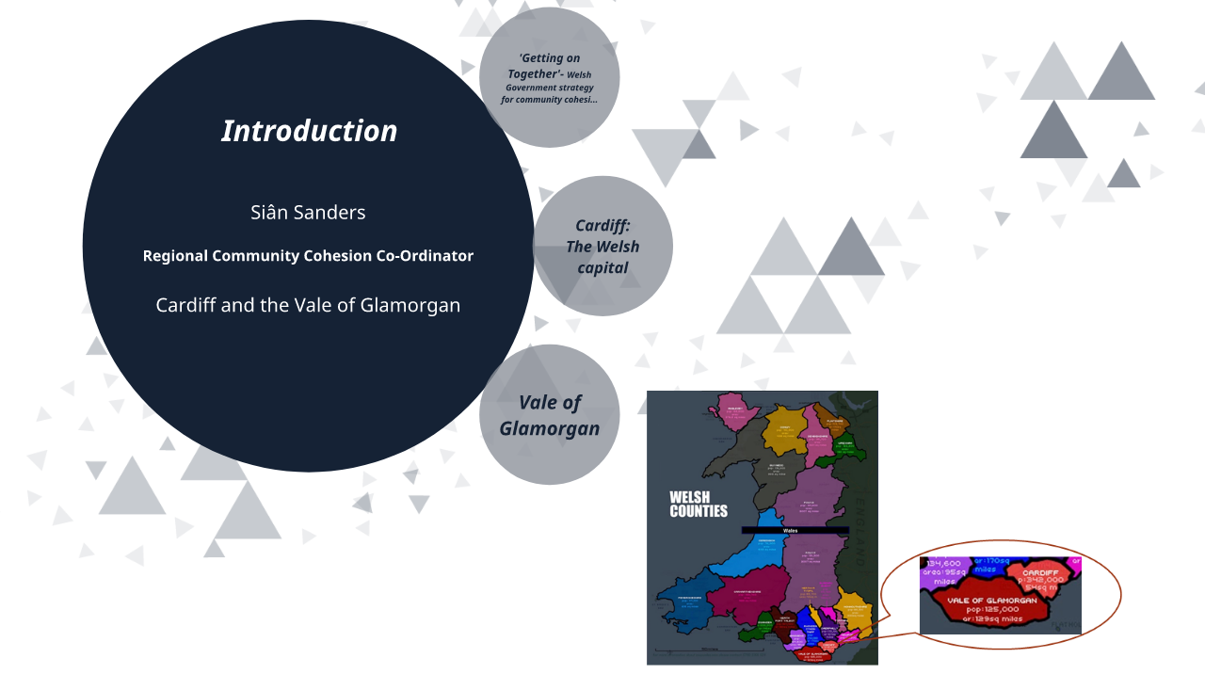

Slide 34
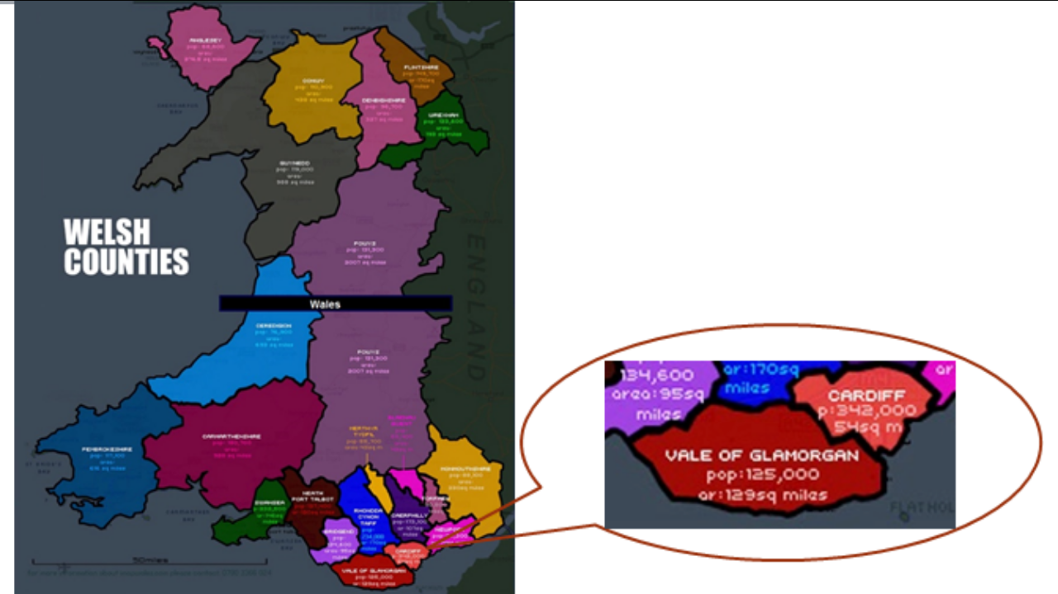

Slide 35


Slide 36
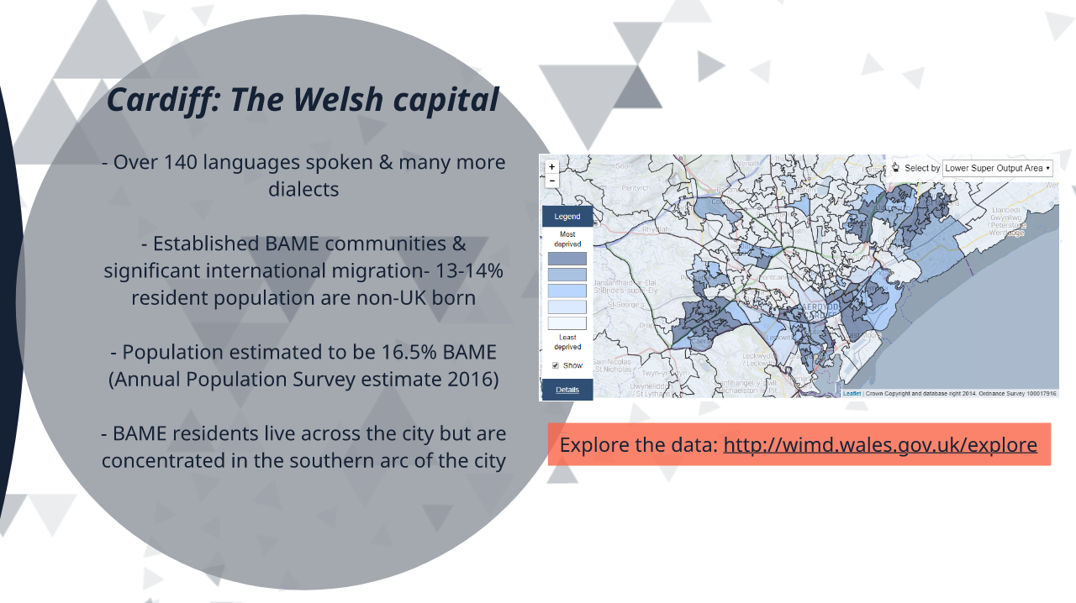

Slide 37
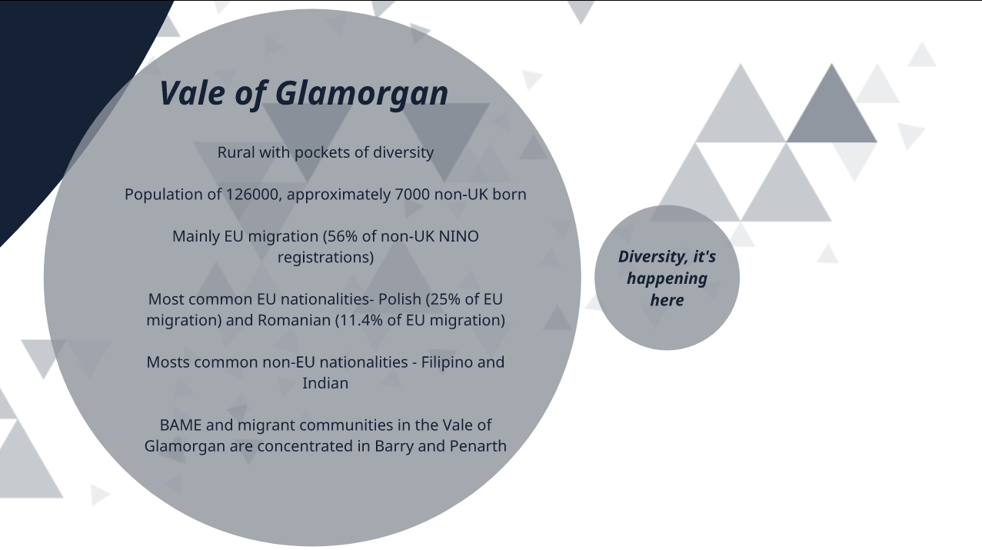

Slide 38
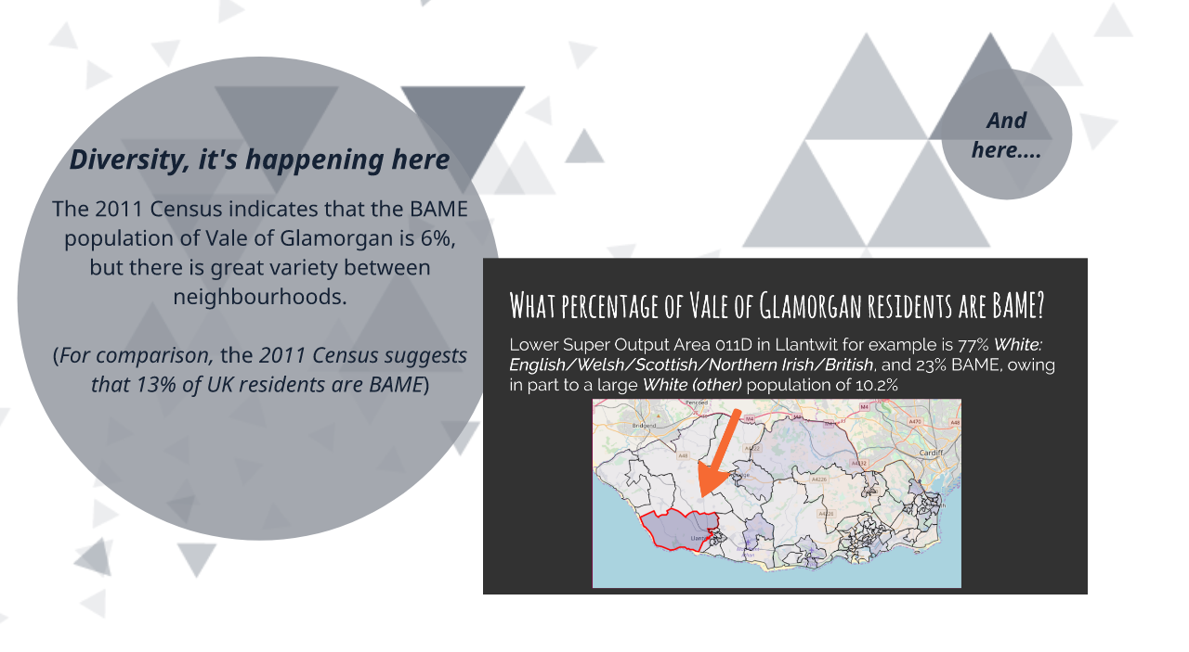

Slide 39
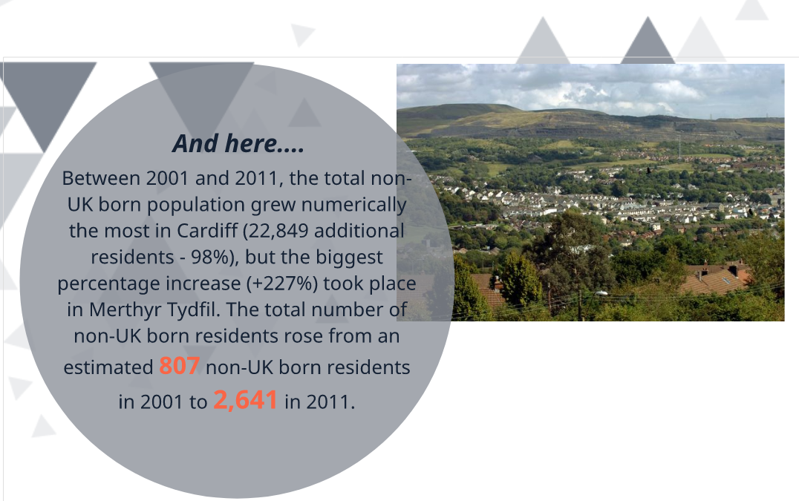

Slide 40


Slide 41
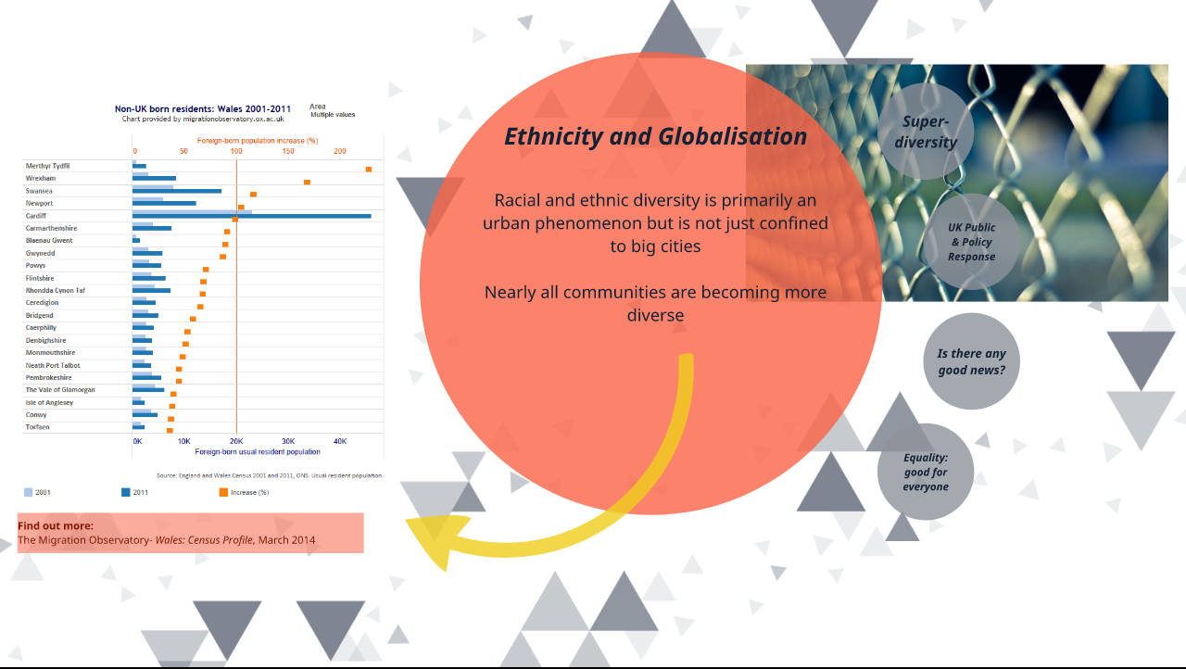

Slide 42
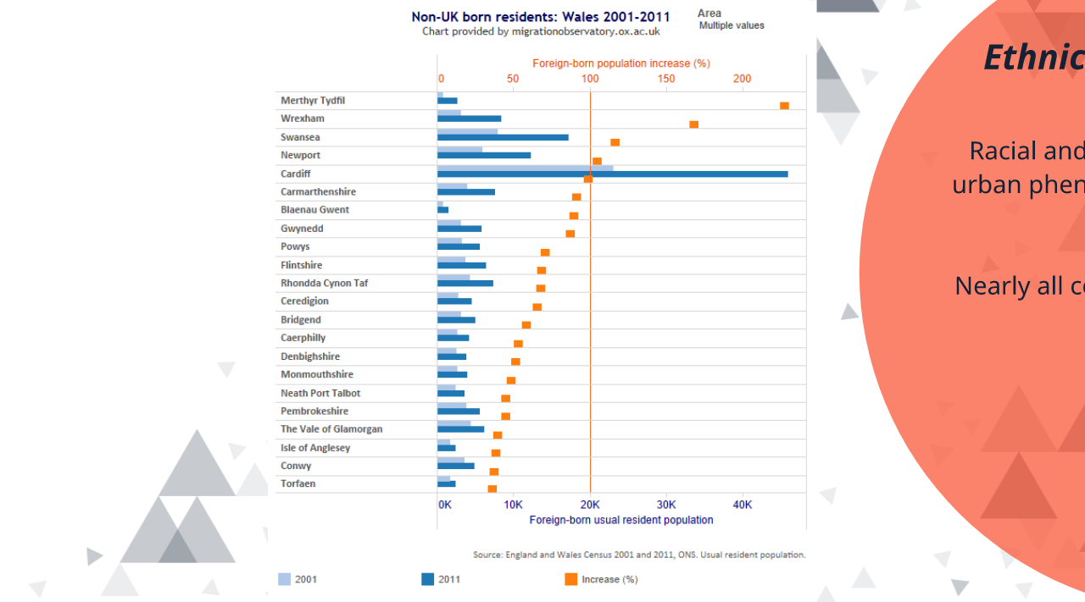

Slide 43
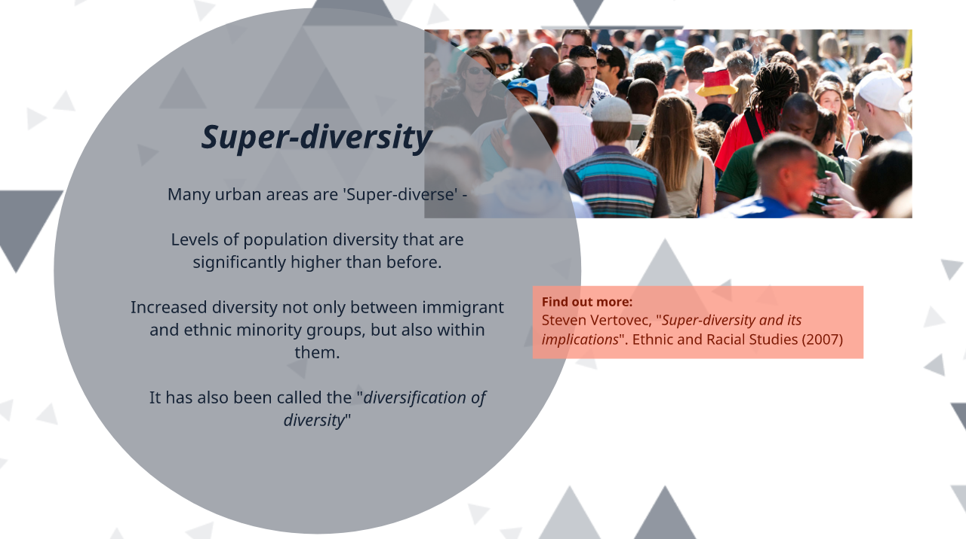

Slide 44


Slide 45


Slide 46


Slide 47
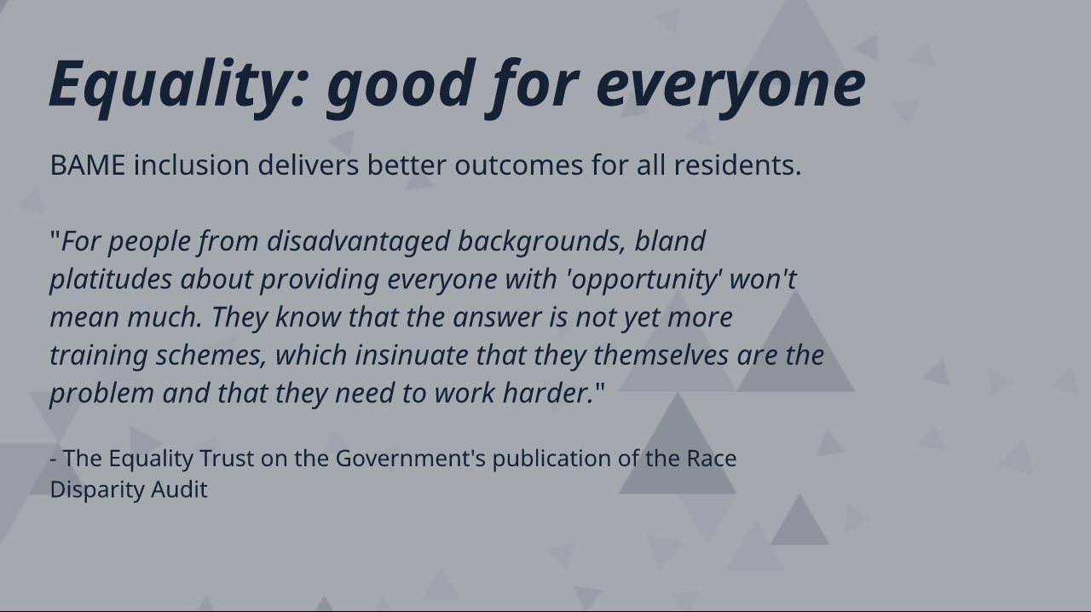

Slide 48
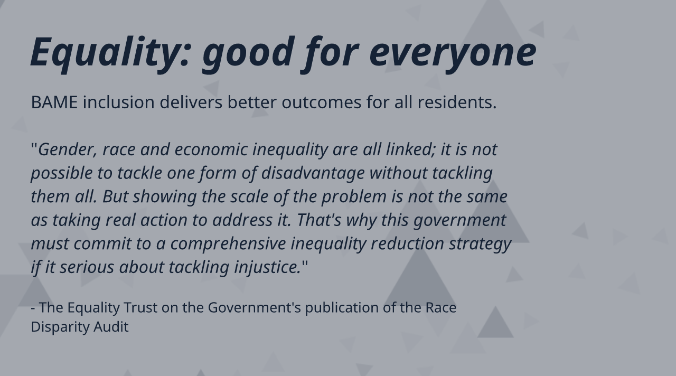

Slide 49


Slide 50
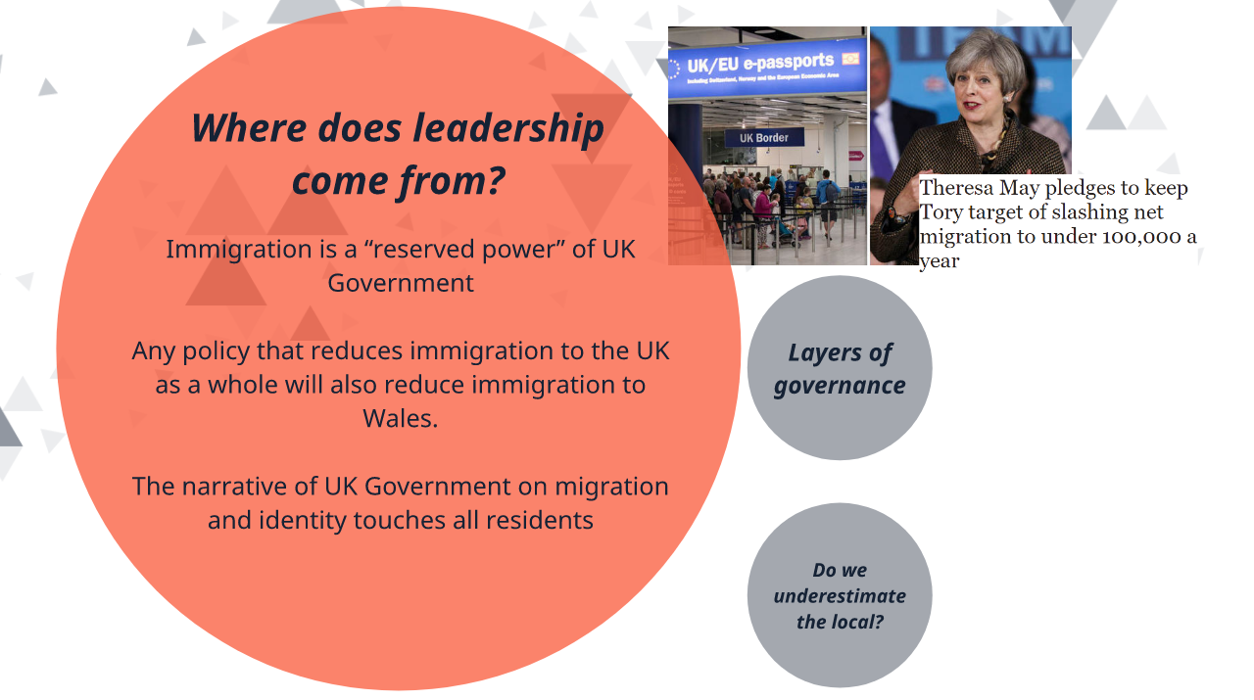

Slide 51
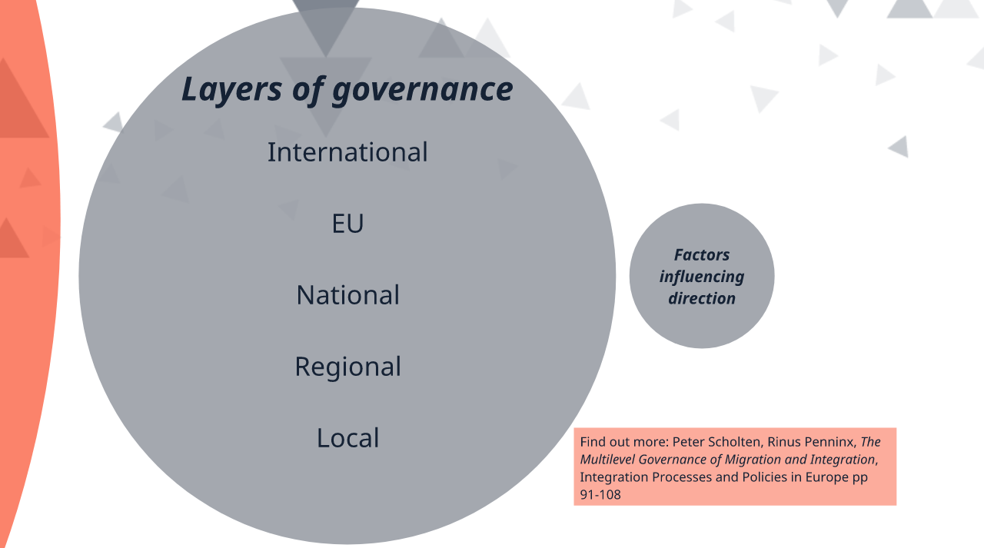

Slide 52
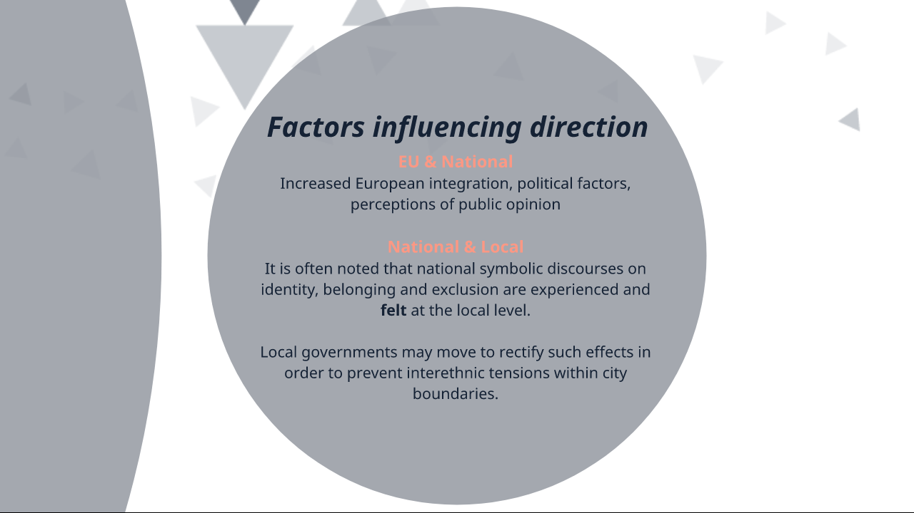

Slide 53
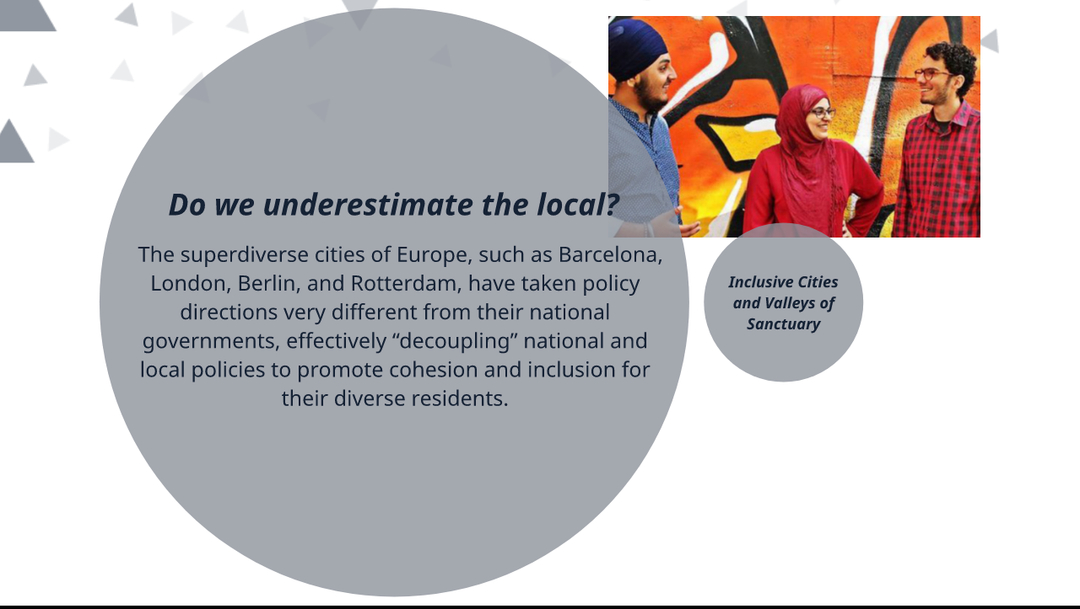

Slide 54
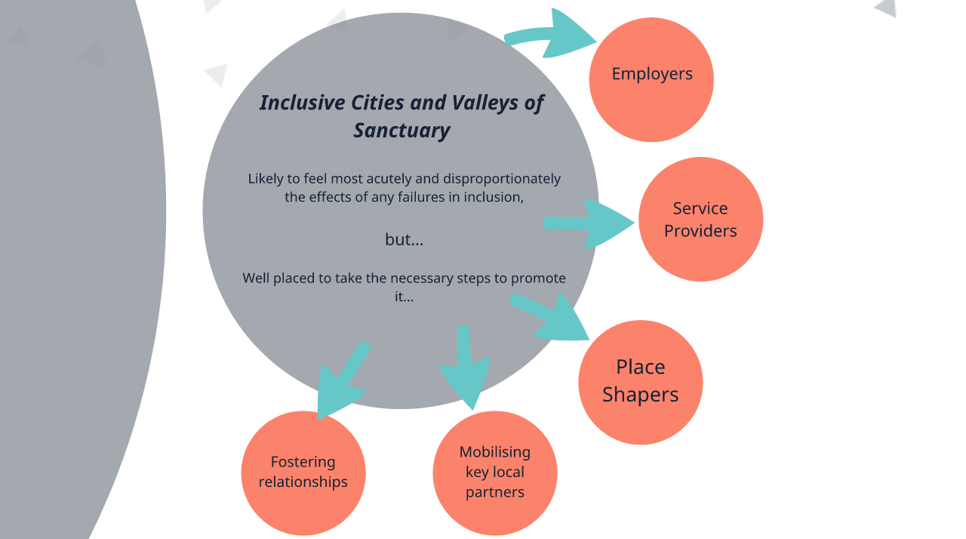

Slide 55


Slide 56


Slide 57
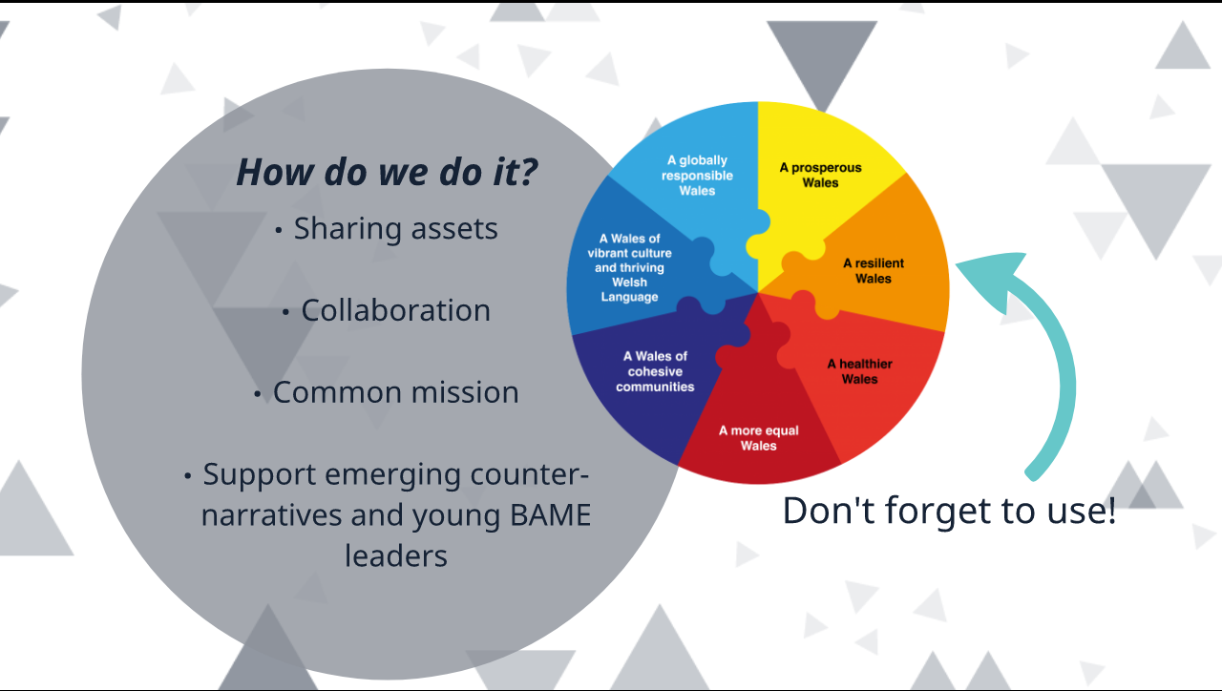

Slide 58


Slide 59
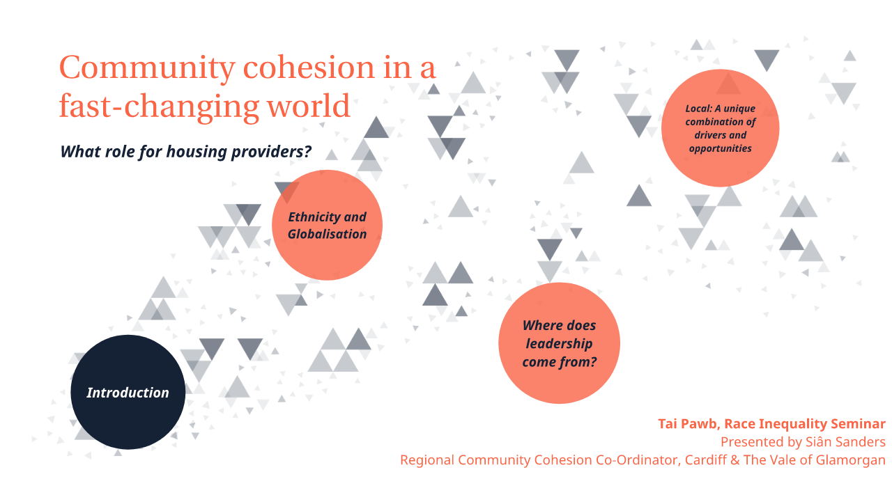

Slide 60
Workshop

Slide 61
Thank You!
Please help us by filling in your evaluation
and equal opportunities forms.

