Slide 1
CCBC Accessible Housing Service
Claire Davies – Interim Private Sector Housing Manager
Sadie Cooper - Senior Practitioner Occupational Therapist
Lauren Allman – Occupational Therapist
Notes:
Front slide.

Slide 2
CCBC Accessible Housing service
Caerphilly County Borough
Situated in South Wales valleys 5th largest local authority in Wales with a population estimated to be 180,462 (2016).
Shared directorate with Social Services
Unified housing service
Deal with all tenures of housing.
Stock retaining

Slide 3
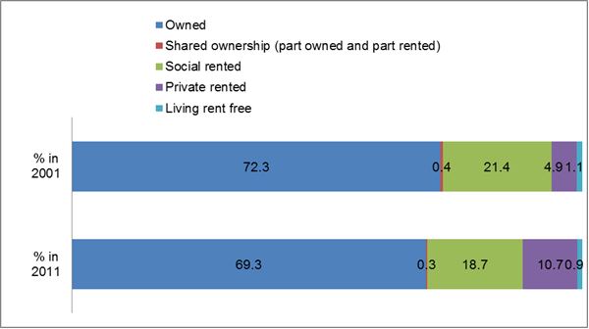
CCBC Accessible Housing Service
At the time of the 2011 Census, there were 74,479 households in the County Borough. As shown below the majority of households own their own home, either outright or with a mortgage.
2011 Census

Slide 4
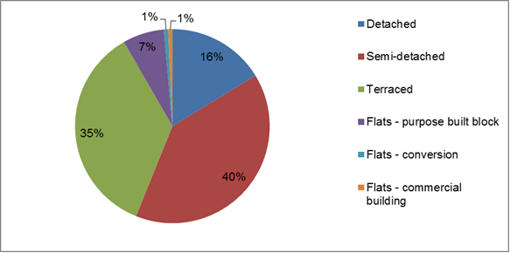
CCBC Accessible Housing Service
Our challenges: Deprivation, topography of the area and type of stock.
2011 Census

Slide 5
CCBC Accessible Housing Service
Census data * highlights that a higher proportion of the Welsh population (7.8%) consider themselves to be in poorer health compared to those in England (4.2%)
* General Health in England & Wales: 2011 and comparison with 2001

Slide 6
Unified Housing Service
Private Sector Housing
Housing Strategy
Public Sector
Housing Repairs operations
Housing Allocations
Housing Options
Welsh Housing Quality Standards

Slide 7
Private Sector Housing
Deals with adaptations major and minor, works collaboratively with Social Services to owner occupiers, private rental sector via the DFG process. Caerphilly Homes stock – via Housing Revenue Account funds adaptations for Local Authority tenants.
Manage the Social Services budget to provide Minor works across tenure.
Assist with relocations when accommodation has been deemed unsuitable to adapt.
Provide an in-house agency service
Housing OT

Slide 8
Housing Strategy
Working to the delivery of 20,000 affordable homes by 2021.
New housing developments:- 1- Work with private developers through the planning process via section 106 agreements.
2- Management of Social Housing grant. Work in partnership with Housing Associations.
3- Other Housing funds i.e., Health and Housing and Innovative Housing.
Local Housing Market Assessment – identifies housing need.
CHR information provided used to asses need and demand for social housing..
Housing OT

Slide 9
Public Sector
Local landlord Service
10802 Properties in the Borough

Slide 10
Housing Repairs Operations
Servicing and Maintenance which includes all ceiling track hoists (private & Public) and all lifts in council stock i.e. stair lift, vertical lifts etc.
Housing OT assists with reassessments of hoists/lifts when not repairable &
Housing OT considers if existing adaptations need to be recycled i.e. removed from property.
Re-use of recycled lifts from private sector into public sector.

Slide 11
Welsh Housing Quality Standards
Large scale improvements across the whole of the Borough, OT assessment identifies provision of bathrooms, kitchen, access etc. suitable to need of tenant.
OT assessment with all sheltered schemes across the Borough
Housing OT works with colleagues when inappropriate housing/need to transfer is identified.

Slide 12
Housing Options
Help with housing problems in areas including e.g., homelessness, renting, debt.
Applying for emergency accommodation.
Link with Housing OT to ensure property offered meets medical needs.

Slide 13
Housing Allocations
Process the Common Housing Register applications.
Includes Senior CHR officer & team of 4 CHR officers.
Housing OT’s
Mental Health assessor (Gofal)

Slide 14
CCBC Common Housing Register.
Operational since Dec 2016
Website launched “ Home search Caerphilly” a dedicated website aimed at providing information on the different housing options available in Caerphilly County Borough.
Equality Impact Assessment prior to CHR to ensure an equitable service.
1 register for all applicants
CCBC properties & 6 HA partners
1 Common Allocation Policy
Accessible housing register sits within the register
CCBC CHRAO’s deal with all applications
All partners shortlist and offer accommodation

Slide 15
CHR Process
Application online – information required about the applicants and their housing needs.
Also promote support with completing application if difficulties identified i.e., telephone application with CHRAO, support sessions in local Libraries through the Borough, customer service and home visits.
Information section with regards to an applicant/s health and physical difficulties &
Information section with regards to an applicant/s mental health

Slide 16
CHR process
CHRAO completes all necessary checks i.e. proof of identify, Child benefit etc..
HOT & MHA complete assessments – desk top, home visits, joint working with other professionals ie hospital/community professionals. Currently working within a 4 week time frame.
HOT assessments determine level of accessibility required and band.
Application updated by CHRAO and applicant is ready for shortlisting.

Slide 17
Level of Accessibility
Person Classification from A to D
A1 Independent wheelchair user. Will require ground floor accommodation or vertical lift access to alternative floors. Access to property must be level or ramped to a minimum 1:12. The accommodation will need to be entirely wheelchair accessible i.e. door widths to a minimum of 780mm
A2 Dependent wheelchair user. Will require ground floor accommodation or vertical lift access to alternate floors. Access to the property must be level or ramped to a maximum of 1:12. Internally full access to the property may not be necessary but essential rooms will need to have door widths of 780mm.

Slide 18
Level of accessibility
B1 Semi ambulant person who is unable to negotiate steps or stairs or who is dependent on a wheelchair out of doors. The property will need to be ground floor or have either stair lift or vertical lift access to alternate floors. Access to the property will need to be level or ramped to a minimum of 1:12
B2 Semi ambulant person who is able to negotiate a limited number of steps. The property may be ground floor or have either stair lift or vertical lift access to alternate floors. Access to the property does not needs to be level but should have a limited number of steps with hand rail provision.

Slide 19
Level of Accessibility
C An ambulant person who is able to negotiate steps and stairs on a limited basis.
D A physically abled person
U An applicant who has indicated health issues but is waiting for assessment. This ensures applicant does not miss out on an opportunity.

Slide 20
CHR Banding system
CHR policy based on simplified banding system, placed into one of three bands depending on an assessment of their circumstances those with the greatest need afford the highest priority. It is a needs based, time and date ordered system.
The allocation scheme has been designed to ensure that reasonable preference is given to the following categories of people i.e. homeless, those owed a duty by the LA, insanitary conditions, over crowding issues, medical grounds/disability & hardship.
Additional preference can also be awarded to those who fall within the reasonable preference categories and who have urgent housing needs.

Slide 21
CHR Banding system
Band 1 Urgent need to move (Reasonable preference plus additional preference) e.g., Hospital discharge, emergency medical or disability, release of adapted property, Armed forces, Homeless with a duty secured etc. - Jan 2018 – 3.20%
Band 2: Need to move – Reasonable preference e.g., Housing conditions exacerbates a serious medical condition or disability, Homeless or threatened with homeless. Jan 2018 – 34.34%
Band 3: Wants to move no reasonable or additional preference. Jan 2018 - 59.45%
The remaining 3.01% -relates to incomplete applications.

Slide 22
Categorisation of properties
Every property must have a level of accessibility category
Mandatory field in the IT system – Abritas.
Essential to enable a void property to be allocated.
Property category – has a corresponding shortlisting criteria.

Slide 23
Adapted or accessible ?
What makes a property adapted?
E.g., Stair lift, Vertical lift, Low level Shower
What makes a property Accessible ?
Level access, widened doorways, adequate circulation space, location.

Slide 24
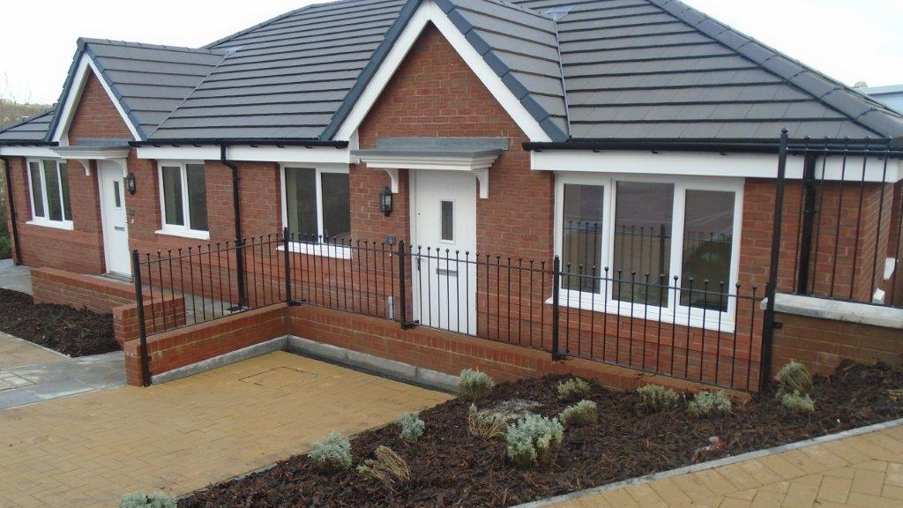
Category A
A wheelchair accessible highly adapted or purpose built property, allowing wheelchair access internally and externally.
2 Subcategories
A1 – wheelchair access throughout the property
A2 – Not all the rooms within the property are wheelchair accessible
Bungalow, Ground floor flat, first floor flat with vertical access or 2 storied house with vertical lift allowing access to first floor

Slide 25
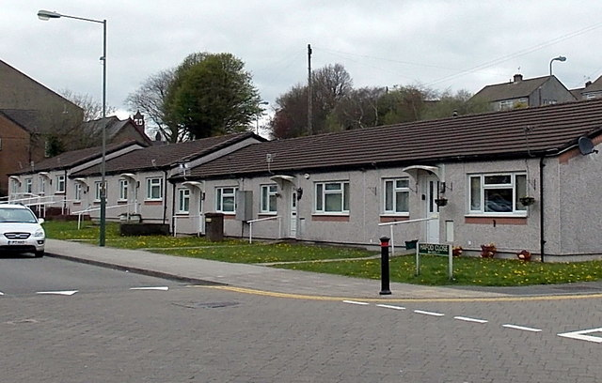
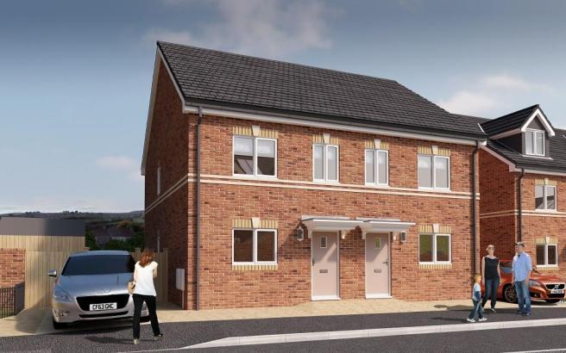
Category B
A property not wheelchair accessible internally but affords good graded access and when necessary is suitable for provision of vertical lift or stair lift.
2 subcategories
B1 – A property allowing external but not internal wheelchair access.
B2 – A property with maximum of 2 steps to main entrance.
Bungalow, Ground floor flat, first floor flat with vertical/stair lift access or 2 storied house with vertical/stair lift allowing access to first floor

Slide 26
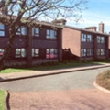
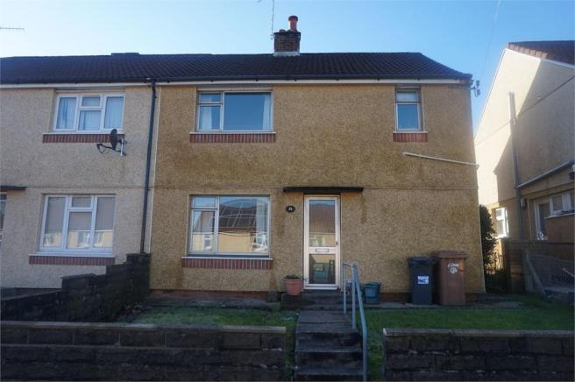
Category C
A property that facilitates limited use of stairs and steps. A property in which lift provision is not possible and has maximum of 5 steps to main external access.
3 sub categories:
C1 First floor property so providing all facilities on one level.
C2 A two stored house with WC facilities to both levels
C3 A ground floor flat or bungalow

Slide 27
Category D
Suitable for general needs
In excess of 5 steps.
Not suitable for allocation to a person with physical disabilities.
Property not suitable for adaptations.

Slide 28
Coding the properties.
Council stock is coded by the Estate Management Officers who are locally based to their area’s.
Housing Officer for the Housing Associations code their stock.
HOT’s provided training prior to CHR
Code reflects best match
Ongoing OT advice for coding properties

Slide 29
Coding properties
CCBC properties across borough by medical category – Abritas report
Medical Category | Total | %
A1 FULL WHEELCHAIR | 274 | 2.5
A2 PARTIAL WHEELCHAIR | 173 | 1.6
B1 LEVEL/RAMPED | 1093 | 10.1
B2 LIMITED STEPS | 573 | 5.3
C1 SINGLE LEVEL FAC | 546 | 5.1
C2 HOUSE WC X 2 | 350 | 3.2
C3 LEVEL FAC GF ONLY | 139 | 1.3
D NOT ADAPTABLE | 1542 | 14.3
Not categorised | 6112 | 56.6
Total | 10802 | 100

Slide 30
Action for the future.
Development of central repository for all CHR stock
This will include type of property and the medical code, property information etc.
Number of properties coded will increase showing a more accurate stock profile throughout Borough.
Ability to compare what exists against unmet need.
Highlight what properties are required moving forward – i.e. consider Enable funding, areas of high demand and new developments etc.

Slide 31
Benefits of Accessible housing register.
Right person to the right property.
Maximise independence.
Reduce demands on health service
Promotion of peoples well being
Maximise use of our existing resources
Information from CHR can provide information requires at strategic level
Minimal refusals

Slide 32
Benefits of Accessible housing register
Minimal refusals – Policy allows 3 reasonable refusals.
Refusals | A1 | A2 | B1 | B2 | C1 | C2 | C3 | D | U | Total
1 offer refused | 3 | 3 | 37 | 33 | 5 | 11 | 32 | 185 | 3 | 312
2 offers refused | 1 |  | 7 | 8 |  | 2 | 7 | 36 | 2 | 63
3 offers refused |  |  | 2 | 2 |  |  | 2 | 15 |  | 21
4 offers refused |  |  | 1 | 1 |  |  |  | 4 |  | 6
5 offers refused |  |  |  |  |  |  |  | 1 |  | 1
Total | 4 | 3 | 47 | 44 | 5 | 13 | 41 | 251 | 5 | 403

Slide 33
CHR 1 Year on.
Applicants on waiting list by age group and medical category.
Age Group | A1 | A2 | B1 | B2 | C1 | C2 | C3 | D | U | Total
16-29 | 1 | 0 | 6 | 13 | 2 | 24 | 2 | 1127 | 10 | 1185
30-44 | 7 | 5 | 26 | 43 | 9 | 39 | 15 | 1005 | 19 | 1168
45-59 | 6 | 12 | 65 | 132 | 25 | 56 | 81 | 596 | 36 | 1009
60-74 | 9 | 12 | 127 | 269 | 14 | 25 | 192 | 337 | 34 | 1019
75+ | 1 | 15 | 94 | 128 | 5 | 0 | 57 | 144 | 11 | 455
Total | 24 | 44 | 318 | 585 | 55 | 144 | 347 | 3209 | 110 | 4836

Slide 34
CHR 1 year on
Introduction of the U code.
Better informed about who needs what & where.
Unmet needs.
Reregistration.
Review and monitor applicants on the register
Better understanding of the stock profile
Development of communication with all staff

Slide 35
Next steps & future challenges
Rapidly ageing society, how to meet future demands.
Work seamlessly & provide joined up services.
Respond to identified needs and deliver timely housing solutions.
Make best use of already adapted properties.
Engagement with health bodies.
Forecasting future demand.
On going involvement with tenant information exchange and consideration for representative to be involved with accessible housing and future developments.

Slide 36
Questions?

