Slide 1
Housing First and the PRS
Alex Osmond, Housing First Policy and Practice Coordinator
Cymorth Cymru

Slide 2
This presentation
Part one: introductions
Part two: Housing First principles
Part three: Housing First in Wales
Part four: Housing First and the PRS

Slide 3
Part 1
Introductions

Slide 4
An introduction
Worked in Higher Education in London
Was a service user in Cardiff
Volunteered at, then started work as Research Coordinator, at The Wallich
Now at Cymorth Cymru

Slide 5
Housing First: history
Housing First as we know it today began in New York in the early 90s, devised by Dr Sam Tsemberis
It was initially an approach to help people with severe mental health issues and substance use issues on the streets of the city
The clients were accommodated without any conditions being placed on them: (that is, nobody said “you must stop using drugs” or “you need to come to three sessions a week”)

Slide 6
Housing First Worldwide
Since then, Housing First has been used across the world
The US had a Housing First programme for veterans in the 2000s, and it is still used in several states
Finland’s entire homelessness policy rests on Housing First
Canada makes extensive use of Housing First
Results are consistently positive

Slide 7
What do I mean by ‘consistently positive’?
Clients in better health and better mental health
Decreased use of emergency services (benefits for clients; savings in short-medium term)
High numbers of people maintain their tenancies (70%+ depending on example)
Reduced number of arrests/incarceration

Slide 8
What do I mean by ‘consistently positive’?
Clients reconnecting with family and loved ones
In some cases, reduced alcohol and substance use

Slide 9
Housing First closer to home
There are Housing First services in Scotland (Turning Point)
It is also being used in England (St Mungo’s, Thames Reach)
We have projects in Wales (Salvation Army, The Wallich, Cardiff Council, to name just a few); many more are on their way

Slide 10
Part 2
The principles of Housing First

Slide 11
What does it mean?
Clients are given choice and control
Support is person-centred and people can engage when they’re ready and willing
A whole range of organisations and agencies are built in to the service from the beginning
Support and housing management are separated

Slide 12
What does it mean?
Housing, first.

Slide 13
The principles
People have a right to a home that is affordable, secure, habitable, adequate both physically and culturally, and with availability of services (as per UN International Covenant on Economic, Social and Cultural Rights). It should also be dispersed in the community and not as part of an institution.

Slide 14
The principles
Flexible support is provided for as long as it is needed.

Slide 15
The principles
Housing and support are separated.

Slide 16
The principles
The service is targeted at individuals who demonstrate a repeat pattern of disengagement with hostel accommodation and/or, individual/s accessing rough sleeping or accessing EOS (Emergency Overnight Stay) at the point when the referral is made.

Slide 17
The principles
Individuals have choice and control.

Slide 18
The principles
A harm reduction approach to substance misuse is used.

Slide 19
The principles
The service is delivered in a psychologically-informed, trauma-informed, gender-informed way that is sensitive and aware of protected characteristics.

Slide 20
The principles
An active engagement approach is used.

Slide 21
The principles
The service is based on people’s strengths, goals and aspirations, and as such has an explicit commitment to a small caseload.

Slide 22
The principles
The widest range of services are involved from the outset (health, substance misuse, mental health, police), so individuals can access them if needed or wanted.

Slide 23
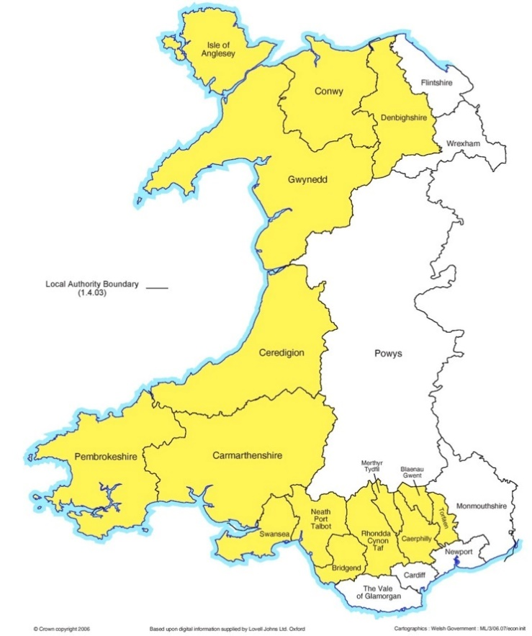
Part 3
Housing First in Wales

Slide 24
Housing First in Wales
Welsh Government
Housing First Wales Network
Cymorth Cymru
Housing First Policy and Practice Coordinator
Housing First for Youth Sub Group
Communication Sub Group
Health and Care Sub Group
Housing Management Sub Group

Slide 25
Housing First Wales Network
A group of experts and practitioners: support providers, Welsh Government, academics, local authority staff
Meet regularly to discuss issues affecting Housing First in Wales
Share good practice and lessons learned
This group devised the principles we’ve just discussed

Slide 26
Housing First Network Sub Groups
Health and Care
Housing Management
Housing First for Youth
Communication
These groups bring together stakeholders from relevant fields
Their discussions feed up into the Network

Slide 27
Next steps
The Housing First Quality Mark
A ‘census’/directory of Welsh Housing First projects
Sharing of good practice and lessons learned

Slide 28
Part 4
Housing First and the PRS

Slide 29
Welsh context: PRS and Housing First
The Wallich’s Housing First project in Anglesey works closely with the local PRS
Cardiff Council Housing First works with the PRS
Salvation Army’s Cardiff Housing First project recently started working with one PRS property

Slide 30
The PRS: opportunities
Lots of housing stock – potential choice and flexibility for clients
Some landlords willing to develop relationships with providers and enable a ready source of supply
The Welsh Government leasing scheme – a contract guaranteeing rent for a period of time? Not much detail at this stage
Some other sort of leasing scheme?

Slide 31
The PRS: negative aspects
Many landlords unwilling to let to people deemed as a ‘risk’
Rent prices too high
RSLs subject to more regulation (rent policy etc)
PRS stock could be old and in bad condition

Slide 32
Final thoughts
Open Doors project highlighted opportunities and negative aspects of the PRS
If Housing First is to become in use much more across Wales, the PRS will probably necessarily be a part of that
How do we encourage increasingly risk-averse PRS landlords to get involved?

Slide 33
Questions?
Contact:
alex@cymorthcymru.org.uk

