Slide 1
Widening access in the PRS
Sarah Rhodes – Head of Homelessness Prevention
Matthew Hall – Head of Private Sector Housing Reform Team
Paul Webb – Head of Housing Support and Welfare

Slide 2
Strategic Context
Housing one of the five priority areas in Prosperity for All
Sets out the Welsh Government’s aim for:
Everyone to have a home that meets their needs and supports a healthy, successful and prosperous life

Slide 3
Homelessness Prevention
Vision:
Work together to prevent homelessness and where it cannot be prevented, ensure it is rare, brief and unrepeated

Slide 4
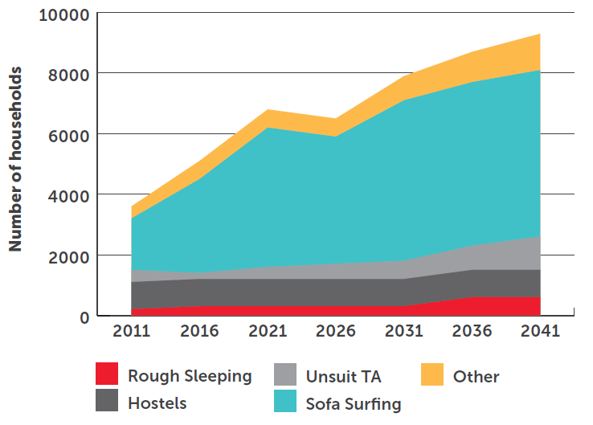
Changing the Narrative – not just rough sleeping
Causes of homelessness

Slide 5
Scale of the problem
Statutory Homeless Figures:
Over 23,500 households prevented from becoming homeless since 2015
Increasing demand:
over 10,500 households presenting to local authorities in 2018-19
over 11,500 owed a duty to secure accommodation as they were already homeless
Then there are future challenges…

Slide 6
Meeting the Challenge
Fresh look at strategic approach:
Shifting policy focus from acute / crisis intervention to prevention and early intervention focus
Shifting from stair-case model to rapid re-housing approach into permanent / long-term housing
Public service focus – this is not just a housing issue
Homelessness Action Group
Expert advice to assist in shifting our approach
Looking at both short term and long term measures

Slide 7
Meeting the Challenge
Housing
Housing Management – allocation policies, supporting households to maintain tenancies and avoid evictions
Shift in Focus – moving away from emergency / temporary accommodation solutions to suitable long term housing options
Increasing Supply – including in the PRS
Single Strategic View – supported by new Housing Support Grant

Slide 8
The Private Rented Sector
Fundamental part of the Welsh housing landscape.
A wider range of people are renting, and for a longer period in their life.
Use of private housing to prevent homelessness
Challenges of standards, access and security of tenure

Slide 9
Welsh Government Action: Legislation
The Housing Act 2014 – Licensing and Registration
Consistency and knowing your rights and responsibilities: The Renting Homes (Wales) Act 2016
Affordability: The Renting Homes (Fees etc.) (Wales) Act 2019
Security of tenure: Consultation on section 173.

Slide 10
Welsh Government Action: Policy Initiatives
Development of a leasing scheme to improve longer term access to PRS properties for some of the most vulnerable.
Protection and reliable income for landlords
Support for tenants
Longer term accommodation
Pathfinder (2019) / evaluation (2020) / roll out (TBC)

Slide 11
Welsh Government Action: Policy Initiatives (cont.)
Support and guidance for landlords – including in respect of mental health.
Training
Signposting
Evaluating existing support
Identifying other early intervention opportunities (rent arrears) and other innovative approaches (passporting).
Discrimination – including in respect of housing benefit / UC.

Slide 12
Supporting People and the Housing Support Grant

