Slide 1
What makes
a diverse board
Alicja Zalesinska @AlicjaTaiPawb

Slide 2
Where are we in Wales?
Diversity is low in the following areas:
Younger people
Race
Disability
Still some way to go on gender

Slide 3
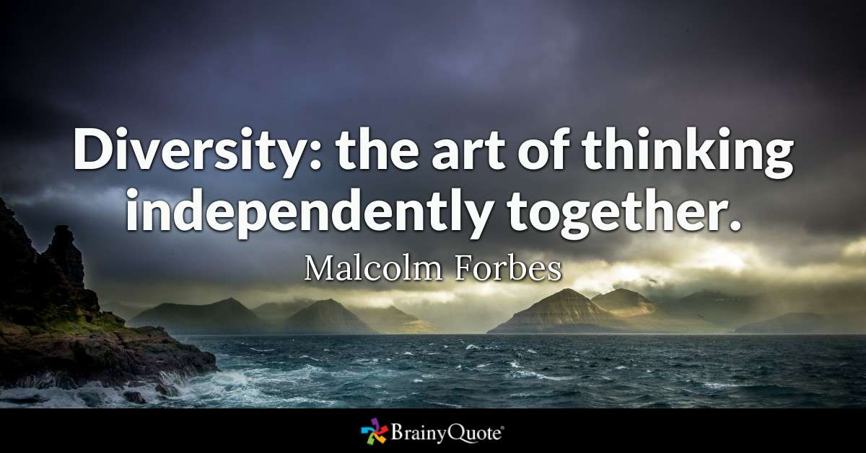

Slide 4
WHY IS DIVERSITY IMPORTANT?
Diverse boards perform better & are more innovative (within inclusive cultures)
Uniformity = complacency, low on challenge, groupthink
Representation vs. reflection
Better analysis of evidence
Helps respond to changing needs of a changing society/tenants’ needs
It widens the talent pool
Help build organisational resilience
Credibility

Slide 5
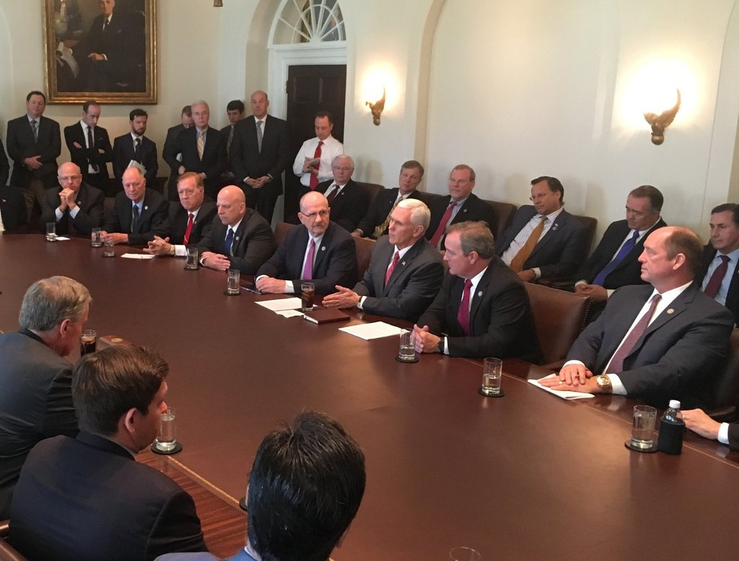

Slide 6
DIVERSITY AND SKILLS
Diversity and skills are not two separate things
Allow for trainee/development spaces
It may mean more effort/investment in recruitment – “Ok, so we have an opening – who do we know?”
Combine social and professional diversity
Talent and diversity not tokenism

Slide 7
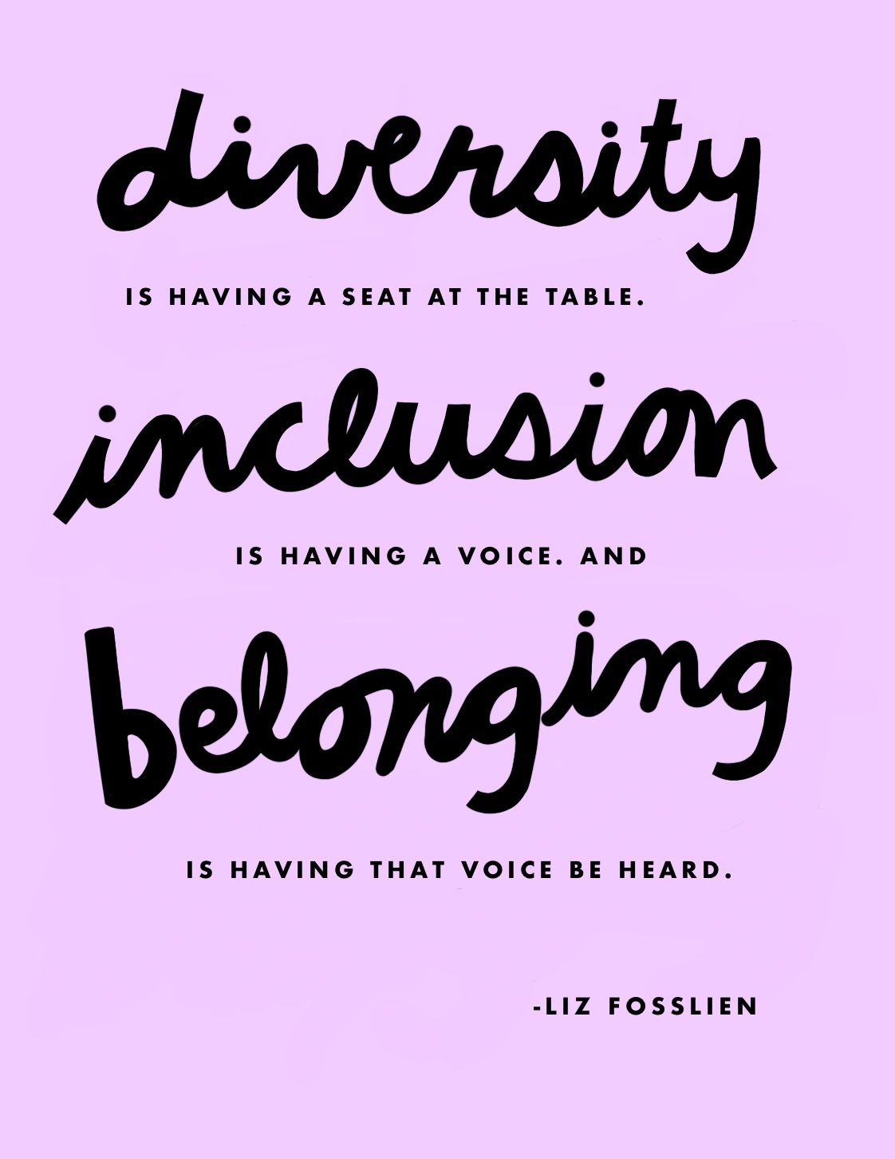

Slide 8
INCLUSIVE CULTURE
Diverse board won’t perform better without inclusive culture
How do you elicit different perspectives?
How do you integrate contrasting insights?
How hierarchical are you? Do you encourage open communication?
Do you welcome strategic conversations on diversity? How high is diversity & equality on your priority list?

