Slide 1
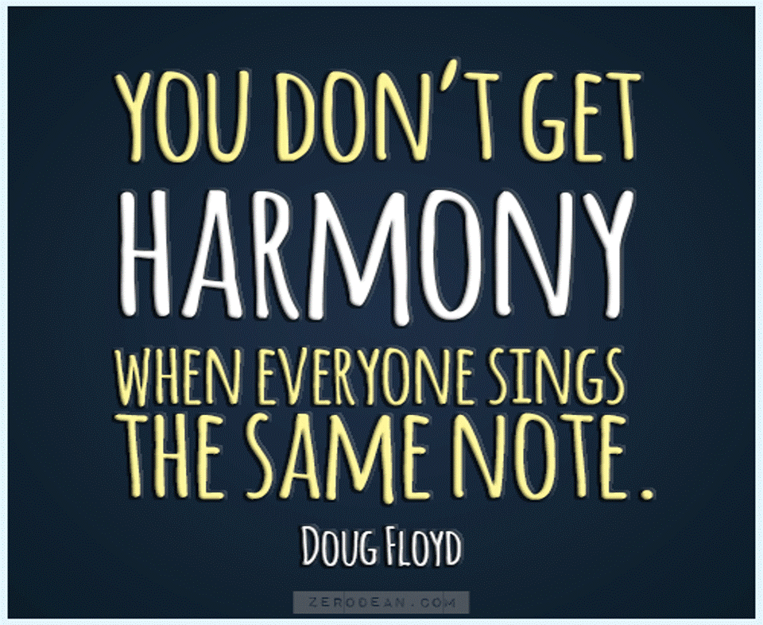
Notes:
"You don't get harmony when everyone sings the same note. These amazing words remind us of the inherent beauty in our differences. And who better to fully understand the meaning of it than us, people living in Wales – the land of song and many many many choirs. Am sure you’re here today to learn more about recruitment in practice from our colleagues in CCHA and United Welsh, but before we do that, we thought it would be valuable to paint a quick picture of where we are on racial diversity in the sector – what is our starting point for embracing those diverse voices.

Slide 2




Notes:
But before I start I think it would be useful to remind ourselves why diversity is so important. I am sure that we are all familiar with the arguments BUT these arguments are so important that I think we should all reflect on them from time to time.
Mini Cooper was designed by a refugee - Alec Issigonis was evacuated from Turkey during the Greek-Turkish war in 1922 and came England at just 16 years old. Diversity is all about harnessing the power of innovation and different perspectives.. When we bring together individuals from different racial backgrounds, we unleash a wider range of unique perspectives, insights, and problem-solving abilities. These varied viewpoints challenge the status quo and stimulate creativity. By embracing racial diversity in our recruitment efforts, we tap into a wellspring of innovation that can propel us!
It is also all about Casting a wider net – job market is competitive for employers - top talent from specific groups will seek organizations that prioritize diversity and inclusion – resarch shows that this is especially important for our younger generations. By embracing racial diversity in recruitment, we position ourselves as an employer of choice, attracting a broader pool of highly skilled candidates from diverse backgrounds WHO previously might not have considered working in housing.
Diversity builds trust and Inclusion: We can all empathise with going to a conference or a meeting or on holiday and feeling that little bit more comfortable because we met or saw people like us. When people from minority groups see people from their own backgrounds represented in the workplace, we feel a sense of belonging, trust and ultimately that can help with engagement and motivation. There are of course much more things that connect us to other people than race but we shouldn’t ignore it because it does matter
Meeting the Needs of Diverse communities. Our organization serves a diverse customer base, and it is essential that our workforce reflects the communities we serve. By recruiting individuals from different racial backgrounds, we gain deeper insights into the needs, preferences, and aspirations of our tenants. This understanding allows us to tailor services, and strategies to effectively connect and engage with the whole diversity of people we serve. Racial diversity in recruitment is not just a business imperative; it is a people-centric approach that ensures we meet the evolving demands of the people that we serve.
Talk about the picture – comms and marketing team of a major global company was all white – coolest monkey in the jungle. Do we think they would have published this had they had a more diverse team? Probably not. That is how greater diversity means we serve our tenants better.

Slide 3
Notes:
So what does diversity look like amongst our staff? The best data we have is our Deeds not Words data from surveys carried out in 2021 and 2023.
What you can also see is that the lowest diversity is amongst middle managers – indicating that we cannot really see diversity in progression – this is something that we would definitely encourage orgnaisations to invest their time in – what are the development opportunities for ethnic mibnority staff? What are the career pathways? What are their perceptions? What do our processes look like.
We would encourage you to track progression in organisations by ethnicity (and other PC’s) but also – most importantly –there is definitely a need to engage with our ethnically diverse colleagues and gauge what their experiences are. I bet there is a wealth of knowledge there.

Slide 4
Notes:
This data was from 2021 – so I think we were getting there but it still didn’t look great – CENSUS 6.3% are non-white and 9.6% are ethnic minroiteis including white migrants
But I think there is some cause for optimism – there clearly has been some focus on increasing diversity of boards in recent years and hopefully these figures will look better this year!
Even if there is a cause to celebrate – we need to build on this momentum, ensure that new board members have the opportunity to share their experience of joining housing boards and that we reflect as organisations on how we sustain this change.

Slide 5
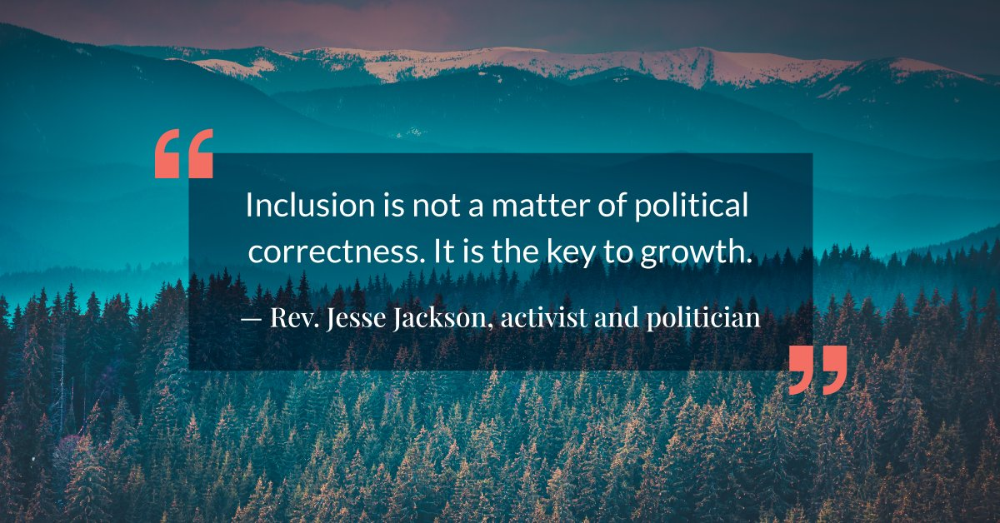
Notes:
In closing, let us remember that the journey towards true diversity in our organizations is not a destination, but a continuous pursuit.
Let’s not be afraid to take the paths less travelled and resist from the temptation to take paths of least resistance. It will certainly require us to have the willingness to test new ways of working and attracting talent and to adopt innovative approaches – even if they seem bonkers.
Lets remain vigilant, challenge our biases and champion the voices that have been marginalized for far too long.
Our commitment to racial diversity is not just a moral imperative; it is an opportunity to tap into the vast reservoir of talent, creativity, and innovation that lies within our diverse communities.
Let us remember that diversity is not a checkbox to be ticked, but a tapestry to be woven. It is the vibrant colors of our differences that will shape a brighter and more prosperous future for our organisations and communities.
.

